Slide 1
Studying for finals
Learning & Accessibility Services (LAS)
12.7.2022

Slide 2
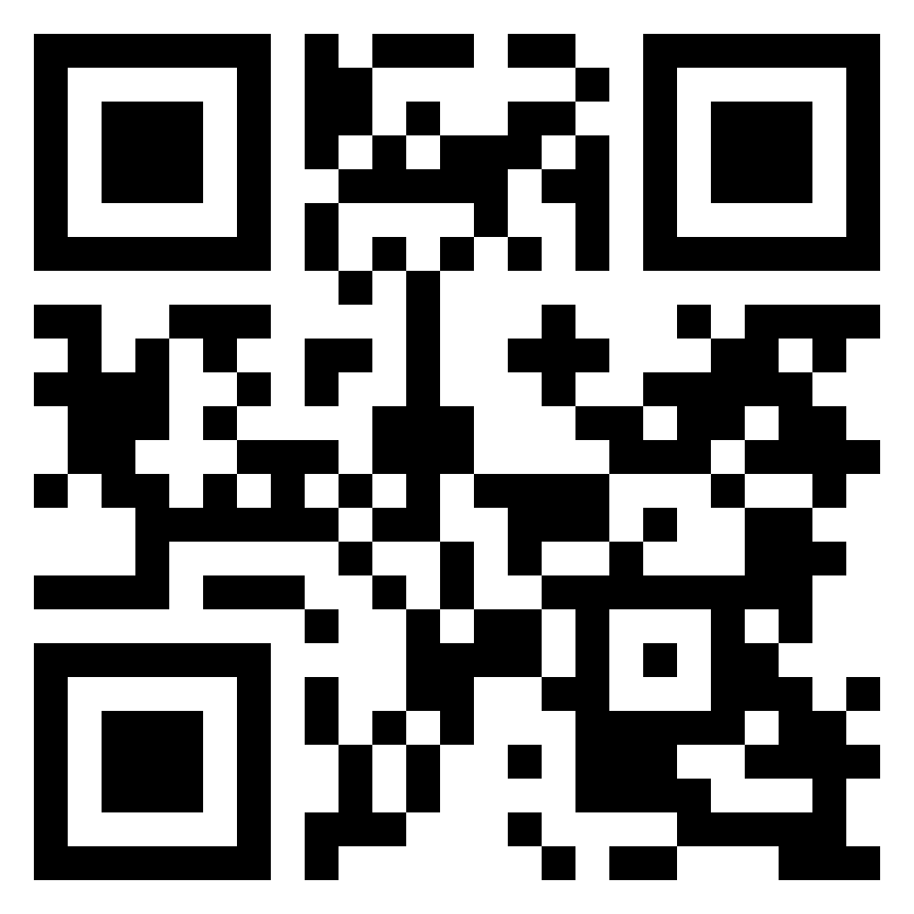
Poll question #1

Slide 3
Notes:
Poll Title: Do not modify the notes in this section to avoid tampering with the Poll Everywhere activity. More info at polleverywhere.com/support What is your biggest challenge when it comes to exams? https://www.polleverywhere.com/multiple_choice_polls/XpnjR3L57lR4zZkFJYPx8?state=opened&flow=Default&onscreen=persist

Slide 4
AGENDA
What not to do
Study Tips & Tools
Combating Test Anxiety
Exam Day
Relaxation Skills
Recap and commit

Slide 5
INTRODUCTION
It’s December 7.
8 days left in the semester.
How are you feeling? What have you learned about being a student? What would you have done differently?

Slide 6
Poll question #2
Notes:
Before we jump into what NOT to do when studying for finals, let’s do another quick poll related to that one thing we all experience-procrastination.

Slide 7
Notes:
Poll Title: Do not modify the notes in this section to avoid tampering with the Poll Everywhere activity. More info at polleverywhere.com/support What is your favorite way to avoid studying? https://www.polleverywhere.com/multiple_choice_polls/tyGN7CHe4Gcy5uVyfoNZm?state=opened&flow=Default&onscreen=persist

Slide 8
What not to do
Avoid or escape
Rely on a “study” group
Cram
Pull an all-nighter
Focus on input not output

Slide 9
Poll question #3

Slide 10
Notes:
Poll Title: Do not modify the notes in this section to avoid tampering with the Poll Everywhere activity. More info at polleverywhere.com/support What do you mean when you say you are going to "study"? What are you going to do? https://www.polleverywhere.com/free_text_polls/2YbTFfevcuMxzYBnrVmBP

Slide 11
STUDY tips & tools
Move from input to retrieval/output
Practice test (create one, take one)
Give a presentation to yourself/others on a topic
Spaced repetition

Slide 12
Saturday | Sunday | Monday | Tuesday | Wednesday | Thursday | Friday
Quiz from previous chapter due at midnight ________ Read Chapter Watch Videos | Sabbath | Read Chapter Watch Videos Reading Questions Due | Retrieval Practice (In Class) | Review chapter/ lecture information | Retrieval Practice (In Class) | Review chapter/lecture information ___________ Begin next week’s chapters/ videos

Slide 13
STUDY tips & tools
Exterior
Simulate testing environment and sensory associations
Interior
Make connections between content areas and to your personal life
Cultivate wonder and awe

Slide 14
Poll question #4

Slide 15
Notes:
Poll Title: Do not modify the notes in this section to avoid tampering with the Poll Everywhere activity. More info at polleverywhere.com/support Do you feel you experience test anxiety? https://www.polleverywhere.com/multiple_choice_polls/HsFGMyK33Es4VKoixZbHr?state=opened&flow=Default&onscreen=persist

Slide 16
Good stress or test anxiety?
What is test anxiety
How to combat it
Notes:
Moderate levels of stress can actually improve motivation, memory, and attention, and enhance test performance. Test anxiety, however, involves stress and worry that interferes with test performance, well-being and attitudes towards school. Symptoms: sweating, nausea, stomachache, shaking, muscle tension, nervousness, feeling like mind going blank.

Slide 17
Combating test anxiety
Cognitive Restructuring
Identify cognitive distortions around test taking
Notes:
Moderate levels of stress can actually improve motivation, memory, and attention, and enhance test performance. Test anxiety, however, involves stress and worry that interferes with test performance, well-being and attitudes towards school. Symptoms: sweating, nausea, stomachache, shaking, muscle tension, nervousness, feeling like mind going blank.

Slide 18
Poll question #5

Slide 19
Notes:
Poll Title: Do not modify the notes in this section to avoid tampering with the Poll Everywhere activity. More info at polleverywhere.com/support Which of these cognitive distortions resonate with you? https://www.polleverywhere.com/multiple_choice_polls/iHnSsRZo95AbUEQm7jL7e?state=opened&flow=Default&onscreen=persist

Slide 20
Combating test anxiety
Cognitive Restructuring
Identify cognitive distortions around test taking
Challenge cognitive distortions (examine their validity, question, de-catastrophize)
Notes:
Moderate levels of stress can actually improve motivation, memory, and attention, and enhance test performance. Test anxiety, however, involves stress and worry that interferes with test performance, well-being and attitudes towards school. Symptoms: sweating, nausea, stomachache, shaking, muscle tension, nervousness, feeling like mind going blank.

Slide 21
Combating test anxiety
Cognitive Restructuring
Identify cognitive distortions around test taking
Challenge cognitive distortions
Use positive self-talk
Notes:
Moderate levels of stress can actually improve motivation, memory, and attention, and enhance test performance. Test anxiety, however, involves stress and worry that interferes with test performance, well-being and attitudes towards school. Symptoms: sweating, nausea, stomachache, shaking, muscle tension, nervousness, feeling like mind going blank.

Slide 22
Positive self-talk examples
“I am well-prepared for this test.”
“I am going to do my best.”
“I can get through this.”
“This is going to be okay.”
“Tests are never as bad as I think they’ll be.”
“Even though I am anxious, I can still do well.”
“I’ll use relaxation skills to calm down.”
“I can see myself passing this test.”

Slide 23
Combating test anxiety
Cognitive Restructuring
Identify cognitive distortions around test taking
Challenge cognitive distortions
Use positive self-talk
Put them somewhere visible as reminders
Link to physical cues
Notes:
Moderate levels of stress can actually improve motivation, memory, and attention, and enhance test performance. Test anxiety, however, involves stress and worry that interferes with test performance, well-being and attitudes towards school. Symptoms: sweating, nausea, stomachache, shaking, muscle tension, nervousness, feeling like mind going blank.

Slide 24
Exam day
Arrive right on time (not too early) or wear headphones to avoid hearing anxiety inducing conversations
Have your positive self-talk ready
Notes:
Moderate levels of stress can actually improve motivation, memory, and attention, and enhance test performance. Test anxiety, however, involves stress and worry that interferes with test performance, well-being and attitudes towards school. Symptoms: sweating, nausea, stomachache, shaking, muscle tension, nervousness, feeling like mind going blank.

Slide 25
Test-taking strategies
Do a “memory dump”
Consider point values
Take your best guess
Check your work
Notes:
Moderate levels of stress can actually improve motivation, memory, and attention, and enhance test performance. Test anxiety, however, involves stress and worry that interferes with test performance, well-being and attitudes towards school. Symptoms: sweating, nausea, stomachache, shaking, muscle tension, nervousness, feeling like mind going blank.

Slide 26
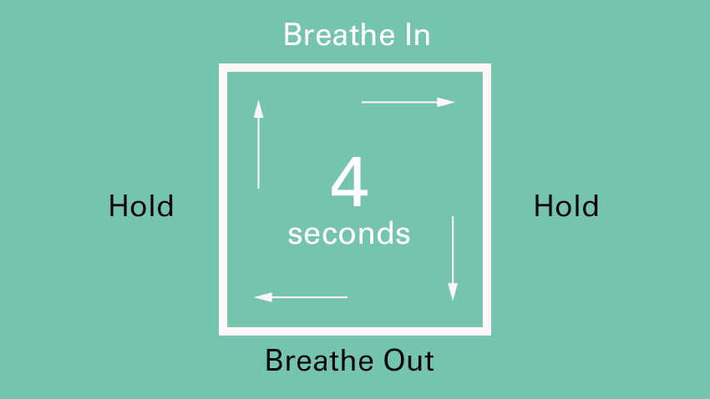
Relaxation skills
Deep breathing / box breathing
Notes:
How to Use Progressive Muscle Relaxation
Sit back or lie down in a comfortable position. You may close your eyes.
Beginning at your feet, notice how your muscles feel. Are they tense, or relaxed?
Tightly tense the muscles in your feet by curling your toes. Hold the tension for 5-10 seconds.
Release the tension from your feet, and allow them to relax. Notice how different the states of tension and relaxation feel.
Move up your body, repeating the cycle of tensing and relaxing each group of muscles. Be sure to practice on the following groups of muscles: legs, pelvis, stomach, chest, back, arms, hands, neck, and face.

Slide 27
Relaxation skills
Deep breathing / box breathing
Progressive muscle relaxation (PMR)
Notes:
How to Use Progressive Muscle Relaxation
Sit back or lie down in a comfortable position. You may close your eyes.
Beginning at your feet, notice how your muscles feel. Are they tense, or relaxed?
Tightly tense the muscles in your feet by curling your toes. Hold the tension for 5-10 seconds.
Release the tension from your feet, and allow them to relax. Notice how different the states of tension and relaxation feel.
Move up your body, repeating the cycle of tensing and relaxing each group of muscles. Be sure to practice on the following groups of muscles: legs, pelvis, stomach, chest, back, arms, hands, neck, and face.

Slide 28
RECAP
What not to do
Studying Tips & Tools
Combating Test Anxiety
Exam Day
Relaxation Skills

Slide 29
Poll question #6

Slide 30
Notes:
Poll Title: Do not modify the notes in this section to avoid tampering with the Poll Everywhere activity. More info at polleverywhere.com/support What new tip, tool, or strategy will you use over the next week? https://www.polleverywhere.com/free_text_polls/dhCJMxZhMGW6HOTsiLqhW

Slide 31
THANK YOU!
Melissa Norton, Joelle Merrifield
Learning & Accessibility Services
www.wheaton.edu/las
las@wheaton.edu

