Slide 1
MOTIVATION
TO
PERSIST
Foundations: A Student Success Series
Feb. 2023
Counseling Center + Learning & Accessibility Services (LAS)
Notes:
Acknowledge this point in the semester and why we chose to focus on this topic

Slide 2
THE PSYCHOLOGY OF MOTIVATION
Holly Wang
Practicum counselor at WCCC
2nd-year CMHC graduate student

Slide 3
EXTRINSIC MOTIVATION
Extrinsic motivation arises from outside of the individual and often involves external rewards such as trophies, money, social recognition, or praise--driven by reinforcement
Two types of motivation
INTRINSIC MOTIVATION
Intrinsic motivation is internal and arises from within the individual, such as doing a complicated crossword puzzle purely for the gratification of solving a problem--driven by value and reinforcement

Slide 4
What motivated you to come today?

Slide 5
While we can use extrinsic motivation as an aid, it is unreliable.

Slide 6
Unhelpful thinking patterns that cause low motivation
-All-or-nothing thinking
-Over-generalizing
-Catastrophizing
-Shoulds, musts, out-tos

Slide 7
To be significant is an innate human desire
"Authentic asceticism is usually quite ordinary, not very exciting at all." -Gerald G. May, Addiction and Grace

Slide 8
WHY DO WE PROCRASTINATE?
-Procrastination is closely linked to anxiety
-Some groups are more prone to anxiety than others

Slide 9
*COUGH*
THE ADHD BRAIN
*COUGH*
Join us for 6 sessions where we’ll discuss the ADHD brain, share our experiences of living with our bizarre and gifted minds, discuss skills and strategies, and brainstorm ways to help our community be more ADHD-informed.
-Date: Tuesday afternoons beginning-1/24/23, ending-2/28/23
-Times: 3:45pm-4:45pm
-Location: Hannay Conference Room in Beamer

Slide 10
ONE (ABSTRACT) SOLUTION: VALUE
Is your New year’s resolution value-based or criteria-based?
PERSONAL VALUES Card Sort
(Miller, Baca, Matthews, Wilbourne, 2001)

Slide 11
Lack of motivation could be a symptom of psychopathology
Wheaton College Counseling Center
counseling.center@wheaton.edu
tel: (630) 752-5000
I promise we don't bite.

Slide 12
ACADEMIC STRATEGIES that MOTIVATE
Melissa Norton
Director, Learning & Accessibility Services (LAS)

Slide 13
What’s your flavor of demotivation?
I feel overwhelmed
I feel lost
I feel insufficient
I feel…??

Slide 14
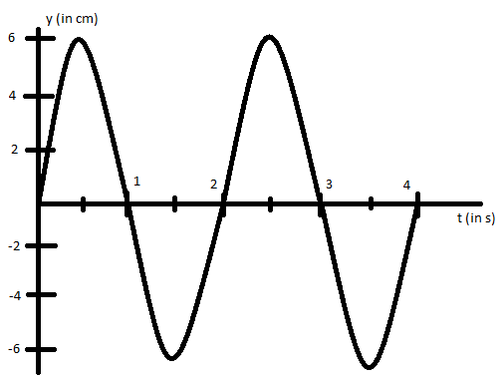
Motivation Graph
Motivation!
Meh
Semester
Low – No Motivation
Notes:
When you find yourself in the low motivation points of the semester we want you to remember, 1) you are not alone, 2) it is not a permanent state of being, and 3) there are strategies that can really help.

Slide 15
Strategies that
Motivate!
1) Scaffolding
2) Change up the modality
3) Academic accountability
4) Inspire yourself
Notes:
Particularly helpful if you feel OVERWHELMED

Slide 16
Scaffolding
CHALLENGE: Can I break the next step down even more??
Something you can complete in 15 minutes.
Example #1: Annotated Bibliography
Research and form topic (2-4 days)
Read and annotate sources (2-3 days for 7 sources)
Write the summaries (1 day)
Edit and format citations (1 day)
Brainstorm 2-3 topic ideas and star the one(s) you feel drawn to (5 min)
Spend 15 minutes and find 2-3 articles on the topic you chose
Meet with a subject librarian to discuss topic and next steps for research (15 min)

Slide 17
Scaffolding
CHALLENGE: Can I break the next step down even more??
Something you can complete in 15 minutes.
Example #2: Reading (50 pages)
Read the headings or chapter summary (5 min)
Write 2-3 questions you want to answer when reading is complete (5 min)
Read for 15 minutes and present to yourself for 1-2 minutes on what you read (17 min)
Example #3: Studying modern/classical language
Have short conversation with tutor (5 min)
Write a paragraph using the vocab words you need to memorize (5 min)
Conjugate 10 verbs (15 min)
Notes:
Low hanging fruit, something where you can experience success and a bit of progress. “I can do anything for 5 minutes”

Slide 18
Change up the Modality
What other mode could you use to make progress…?
If your assignment is to write… try SPEAKING
If your assignment is to write…try DRAWING
If your assignment is to read…try LISTENING
If your assignment is to study…try PRESENTING
Can you think of any others??

Slide 19
Academic Accountability
Meet with a professor/TA and tell them ahead of time what work you will have to show them or something specific that you will have finished by that meeting.
Schedule an appt with LAS or a Peer Coach to report on what your goal is and how you are going to keep moving ahead on it
Consider if there is a friend who can hold you accountable by helping to check in with you on your specific goal
Make an appointment with the Writing Center or a Subject Librarian to hold yourself accountable to progressing through stages in your research or writing process
Notes:
Refer to the difference between intrinsic and extrinsic motivation and give ideas of how to externalize it

Slide 20
INSPIRE YOURSELF
Environment: What can you change about your study space to inspire yourself?
Physical: Movement can be inspiring – study walk, dance party
Content: Make it personal, make connections, cultivate wonder/awe
Make it fun and rewarding when you do the hard thing
Post motivational phrases that are personally meaningful

Slide 21
MOTIVATIONAL PHRASES
Make your own sticker(s) with motivational phrases for this semester. Choose from these or make up your own!
Progress, not perfection
Avoid avoidance
Do the thing
Don’t do the thing
Go offline!
Get out of bed!
Write like it matters, and it will
Remember your WHY

Slide 22
We’re Here for You!!
Learning & Accessibility Services (LAS)
las@wheaton.edu
SSB 209

