Slide 1
Reading in the Social Sciences
Brian Miller
October 4, 2023

Slide 2
 | Arts | Humanities | Social Sciences | Natural Sciences
SHORT DESCRIPTION | Creative expression and reflection | The study and interpretation of the human experience | The study of human behavior and social relationships at all levels | The study of natural phenomena
METHOD | Creating | Producing and interpreting “texts” | Empirical evidence (often scientific method) | Scientific method
GOALS | Reflection on what it means to be human | Ask/answer questions regarding the human condition | Just society, social wrongs righted | Discovery, progress
CHRISTIAN LIBERAL ARTS | The task of co-creation, reflecting the image of God | Promoting knowledge, imagination, and wisdom | Restoring human relationships | Stewardship of Creation
Ideas drawn from Davis, Jeffry C. and Philip G. Ryken. 2012. Liberal Arts for the Christian Life. Wheaton, IL: Crossway.

Slide 3
What is the argument?
Often clearly stated in the Introduction and Conclusion (and abstract for an article)

Slide 4
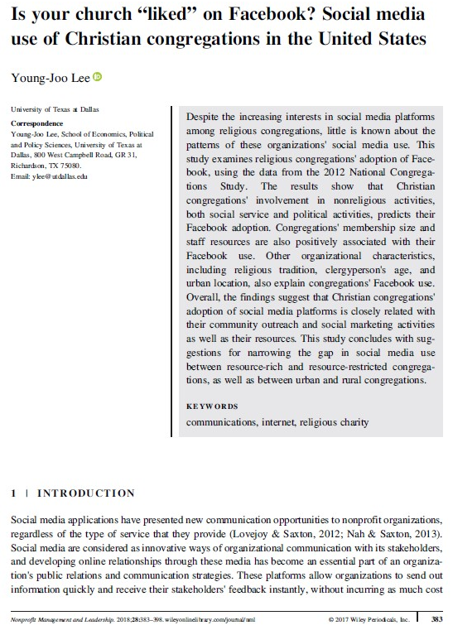

Slide 5
What is the argument?
Often clearly stated in the Introduction and Conclusion (and abstract for an article)
Elements of a social science argument:
1. What is the research question? OR What social phenomena are they interested in understanding/explaining?
2. What scholarly conversation(s) are they engaging? What theories are they interacting with?
3. What methods do they utilize?
4. What are the findings?
5. What does it mean (for theories and existing research, future research, policy, society, etc.)?

Slide 6
Additional matters:
Purpose of the work: exploratory, descriptive, explanatory
Who is the audience (scholars in the same discipline, scholars in different disciplines, policy makers, public, etc.)?
Often discipline-specific: methods, style and formatting (order of writing, citations), jargon

Slide 7
Note taking strategies:
Can you summarize the argument in a sentence or in a minute?
Identify argument and trace evidence for it throughout work
Organize notes by different elements of social science argument
One paragraph summary of argument and findings + one paragraph application to your work

Slide 8
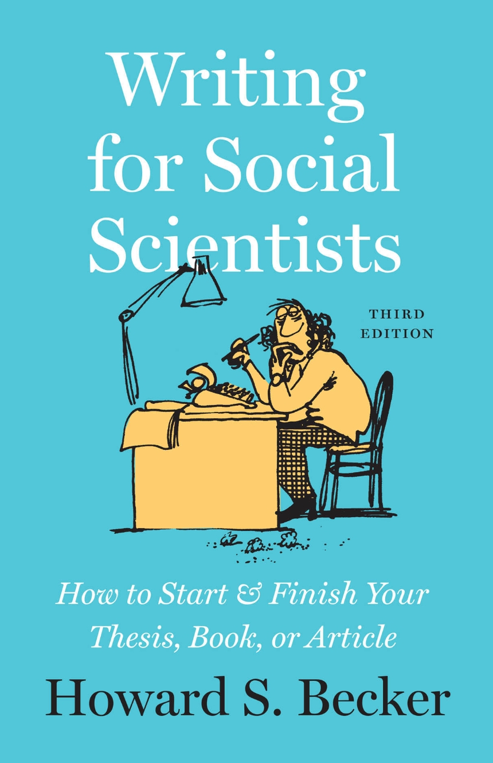
Resources
Research methods textbooks

Slide 9
Reading in the Natural Sciences (or at least in my corner of the Natural Sciences, which is public health & epidemiology)
Dr. Allison Ruark
Assistant Professor of Public Health
Dept. of Biological and Health Sciences

Slide 10
 | Arts | Humanities | Social Sciences | Natural Sciences
SHORT DESCRIP-TION | Creative expression and reflection | The study and interpretation of the human experience | The study of human behavior and social relationships at all levels | The study of natural phenomena, and human health and health-related behaviors
METHOD | Creating | Producing and interpreting “texts” | Empirical evidence (often scientific method) | Scientific method
GOALS | Reflection on what it means to be human | Ask/answer questions regarding the human condition | Just society, social wrongs righted | Discovery, progress, justice
CHRISTIAN LIBERAL ARTS | The task of co-creation, reflecting the image of God | Promoting knowledge, imagination, and wisdom | Restoring human relationships | Stewardship of Creation, promoting human health & flourishing (shalom)
Diagram courtesy Brian Miller. Ideas drawn from Davis, Jeffry C. and Philip G. Ryken. 2012. Liberal Arts for the Christian Life. Wheaton, IL: Crossway.

Slide 11
Sections of a research article & correspondence to scientific method
Section | Description | Steps in scientific method
Abstract | Short summary of all further sections of the article
Introduction | Reviews previous research, gives context, introduces theory, states one or more hypotheses | Make an observation Ask a question Form a hypothesis
Methods | Describes how data were collected & analyzed, including describing study setting | Gather data, carry out experiment
Results | Describes and analyzes data, usually includes tables & figures | Analyze data
Discussion | Interprets data (often in reference to other research), suggests directions for further research, states limitations | Draw conclusions Repeat scientific method (iteration)
Conclusion | Restates major findings and conclusions

Slide 12
Suggestions for reading a scientific article
ABSTRACT
Read this first to get an overview of the entire paper
INTRODUCTION
The literature review is a great resource if you’re planning to do further research on this topic; otherwise you may choose to skim some parts
Pay attention to the hypotheses; usually stated in last paragraph of Intro
METHODS
Read closely if you are learning about or critiquing the methods; otherwise you may choose to skim, particularly if the methods are beyond your knowledge level
RESULTS
Focus on what you particularly want to learn from the article, and how the data support or don’t support the hypothesis
DISCUSSION
Look for Tables or Figures that summarize the results - Table 1 usually describes the study population, and the last Table usually presents the most important findings
Read after you’ve read the Results, and consider if you agree with the interpretation
CONCLUSION
Not essential, but may provide brief and helpful summary of findings
My tips: print it out, mark it up, take notes

Slide 13
Other considerations in reading epidemiological research
What are possible sources of bias? How might the results not be valid?
Who or what is left out of the research? What research questions are not being asked? (questions of justice, representation)
How does this research matter to the health of real people in the real world?
How do we view the research through the lens of God’s truth and intentions for human beings?

Slide 14
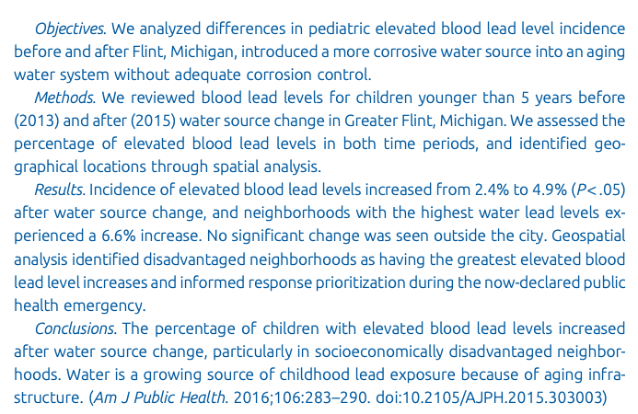

Slide 15
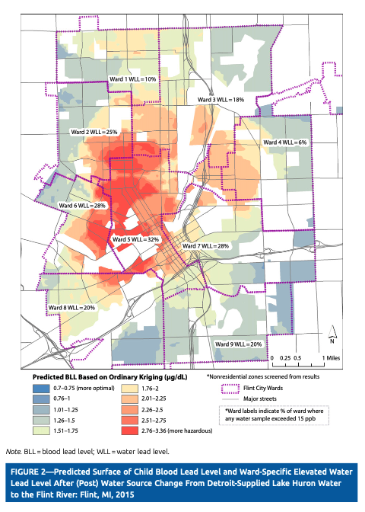
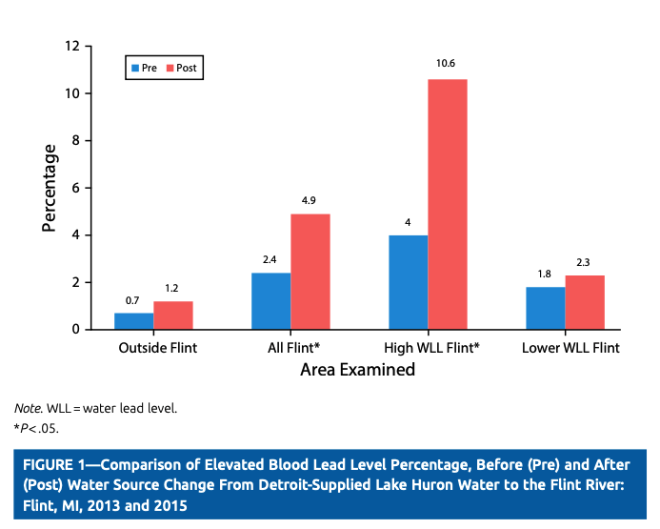

Slide 16
Reading in the Humanities
Tamara Townsend
Associate Professor of Spanish

Slide 17
 | Arts | Humanities | Social Sciences | Natural Sciences
SHORT DESCRIP-TION | Creative expression and reflection | The study and interpretation of the human experience | The study of human behavior and social relationships at all levels | The study of natural phenomena
METHOD | Creating | Producing and interpreting “texts” | Empirical evidence (often scientific method) | Scientific method
GOALS | Reflection on what it means to be human | Ask/answer questions regarding the human condition | Just society, social wrongs righted | Discovery, progress
CHRISTIAN LIBERAL ARTS | The task of co-creation, reflecting the image of God | Promoting knowledge, imagination, and wisdom | Restoring human relationships | Stewardship of Creation
Diagram courtesy Brian Miller. Ideas drawn from Davis, Jeffry C. and Philip G. Ryken. 2012. Liberal Arts for the Christian Life. Wheaton, IL: Crossway.

Slide 18
Interpreting “texts”
“Texts” understood broadly
Traditional literary genres (novels, plays, poetry)
Other cultural products (film, advertisements, museum display)
Primary, secondary, theoretical (tertiary)?

Slide 19
Primary, secondary, theoretical texts
Primary texts: literary works (historical documents, philosophical essays, the Bible)
Secondary texts: articles (or textbooks, websites, etc.) discussing the meaning of those primary works. Typically looking at one particular theme or aspect of the work’s meaning or interpretation, guided by a certain set of theoretical questions
Theoretical texts: describe these guiding questions

Slide 20
Questions for Primary Texts (in literature)
Form
Genre, divisions, style, language
Content
characters, plot, setting, major themes, message
Context
author’s life, cultural values, historical events, other texts of the time period

Slide 21
Questions for Secondary texts
What is the author’s thesis? Usually stated near the beginning and in the conclusion.
What aspects of the primary text do they focus on to support the thesis? What do they leave out?
What is the author’s theoretical approach? (Can be a combination of theories.)
Some examples:
economic relationships (Marxism); gender dynamics (feminism); ethnic identity (postcolonial theory, critical race theory); characters’ personal struggles (psychoanalysis); opposing meanings that co-exist within the work without resolving (deconstruction); how the work’s meaning has changed over time and in different contexts (new historicism)

Slide 22
Examples
Feminist approach
New historicist
Deconstructive
Parker Aronson, Stacey L. “They Said, She Said: Making the Case for Rape in Fuenteovejuna.” Bulletin of the Comediantes, vol. 67, no. 2, 2015, pp. 33-47.
Thesis: The author discusses 17th century attitudes toward—and literary portayals of—gender violence, as well as the reactions of many 20th century scholars to the play’s pivotal (implied) rape scene.
Parker, Jason T. “Recruiting the Literary Tradition: Lope de Vega’s Fuenteovejuna as Cultural Weapon during the Spanish Civil War.” Bulletin of the Comediantes, vol. 62, no.1, 2010, pp. 123-43.
Thesis: The author discovered that the two opposing sides of the Spanish Civil War both found inspiration for their respective causes in Lope’s classic Fuenteovejuna. Each side emphasized some aspects of the play’s complex meaning and downplayed others.
Stroud, Matthew D. “The Play of Means and Ends: Justice in Lope’s Fuenteovejuna.” Neophilologus vol. 92, 2008, pp. 247-262.
Thesis: Most readers agree that the play’s outcome exemplifies justice, but upon considering many conflicting definitions of justice, this conclusion is less clear. One could equally argue that the play exemplifies a Machiavellian attitude of “the ends justify the means,” where the real goal is for the powerful to remain in power.

Slide 23
“Big picture” questions you might expect in class at Wheaton College, but many scholars don’t directly address
How does the work’s theme reflect concerns of the time and culture of original publication?
How might this theme be relevant in our own context? How might today’s readers think differently than the original audience?
In the Wheaton College classroom: What values or worldview is evident in the text? To what extent is the work’s message compatible with the Gospel? What would a Christian reader affirm in the work?

