Slide 1

Avoiding Distraction when Studying
Dr. Aimee Callender
LAS Foundations Series
April 5, 2023

Slide 2
Multitasking
Reducing Distractions when Studying
Reducing Distractions in the Classroom
Mind Wandering

Slide 3
2 Things for you to Remember:
1. Humans are not good at multitasking
2. If you think you are a good multitasker, go back to #1.

Slide 4
You’re thinking…..
Not Me! I’m great at multitasking!

Slide 5
Let’s try a simple experiment….
Recite the following out loud:
Count 1-26
Say the letters from A-Z
Now, alternate between the numbers and letters.
Notes:
How much longer did it take when you did one then the other vs. alternating?
It look a long time.
Cost to task switching.o

Slide 6
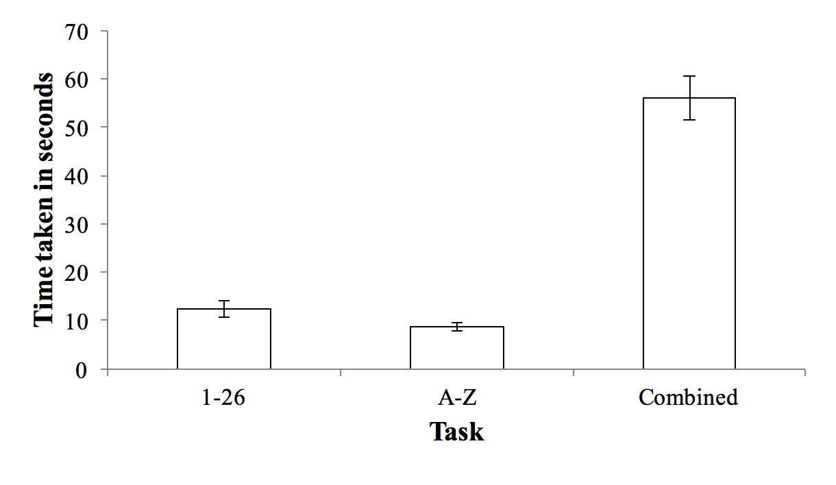
Notes:
It’s not an additive effect, it’s much worse than that!
But, you say, that’s going back and forth, that’s not really multitasking.
But it is. We can’t really do 2 things at once unless both are automatic. In cognition, automatic means that it’s fast, but it also means that we don’t think about it, process it, or do anything with it cognitively. It largely happens without conscious intention or awareness.
This isn’t what you want to be doing when you’re studing, right?

Slide 7

People who rate themselves as high on multitasking ability…..
Perform worse on tests of attention and memory.
Ophir et al., 2009

Slide 8
Reducing Distractions when Studying

Slide 9
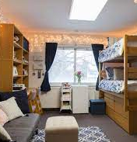



Which is this the best place to study?

Slide 10
What counts as a distraction?
Internal thoughts?
Music?
Background noise?
Videos?
Friends?
Social Media?
Phones?
Notes:
You don’t need a quiet space.
In fact-research shows that processing some sensory information actually reduces your susceptibility to distraction.
Music with lyrics tends to be more problematic
White noise
Ocean sounds

Slide 11
What to do about distraction?
Be aware of how your environment can lead to distraction.
Make choices about where to study to reduce distraction.
Pomodoro Method
  25 minutes Study, 5 minute break
Sleep!
Notes:
Don’t do something during the 5 minute break that you can’t finish!

Slide 12



Your phone as a distraction…
Notes:
Phone is next to you on the desk
Phone is in another room
Phone is in your bag with you.
When it is next to you it is the most distracting, when it is in another room it is the least distracting.
And, again, people who are most dependent on their cell phones are most distracted by them when they are in the same room.

Slide 13
What can we do about cell phone distraction?
Silence it
Put it in another room (if possible)
Put it in your bag
Avoid pulling it out just to check it.
  Other app notifications can increase time spent on the phone up to 400%! (Leiva, 2012)
Notes:
How often do you check your phone just to check it? And then get distracted and pulled into doing something else?

Slide 14
Reducing Distractions in the Classroom

Slide 15
Reducing Distractions in the Classroom
Should I take notes on paper on on the computer?
  When distractions are removed, both result in similar levels of performance
  Computers invite more distractions

Slide 16
Reducing distractions when taking notes on your computer
  Only have your note-taking app open
  Turn off any chat/email notifications
  Don’t open up a web browser—too easy to endlessly go from website to website
  Think of something you want to look up? Jot down a note so you can look it up later

Slide 17

What about distractions we can’t control?

Slide 18
Choose where you sit
  Front of Room
    Less distracted by screens in front of you
    More social pressure to pay attention
  Does looking out the window distract you?
  Do people walking by the classroom distract you?
  Are friends next to you distracting you?

Slide 19
Mind Wandering

Slide 20
General tips
Sleep disturbances increase mind wandering.
  Too little sleep OR Excessive Sleep
Use peer-pressure to keep yourself on track.
Mindfulness training
Checking-in on yourself
Notes:
The attention monitoring only training condition
The attention monitoring only training condition consisted of meditation training that included training sustained attention to breathing sensations, body sensations, thoughts and emotions, as well as a meta-awareness of cognitive, emotional, and physical events (e.g. “You can notice when your mind wanders off using the label “distracted”, and then return to monitoring your breathing”). Unspoken labeling of such events (e.g., “thinking,” “feeling”) helped to foster concentration upon the attentional object (e.g., breath sensations). No instructions designed to foster acceptance of ongoing experience were included.
The attention monitoring + acceptance training condition
The attention monitoring + acceptance training condition consisted of similar instructions to those for the attention monitoring-only training condition, plus instructions to attend to breathing sensations, other bodily sensations, emotions, and thoughts with an accepting and non-judgmental attitude toward those experiences (e.g. “Most importantly, there is no need in this practice to judge yourself negatively, because becoming distracted is just part of the practice of training your attention”).

Slide 21
Mind Wandering when Studying
Reading out loud reduces mind wandering.
  Listening to text increases mind wandering.
Increase your interaction with the material
  Question yourself
  Take notes
  Explain
Self-Checks
  Set a timer for 5 minutes. Are you mind wandering?

Slide 22
Mind Wandering in the Classroom
Students at the first 1/3 of the classroom report less mind wandering
Self-Checks
  5 minute check-ins
  End of slide check-ins
Is there something you’re worried about? Something you need to do later?
  Unfinished business creates internal distractions
  Jot down your thoughts, reminders, etc. right before class

Slide 23
Distractions are inevitable, but you can set yourself up to create the best environment possible.

